Slide 1
CP Bootcamp Project

Slide 2
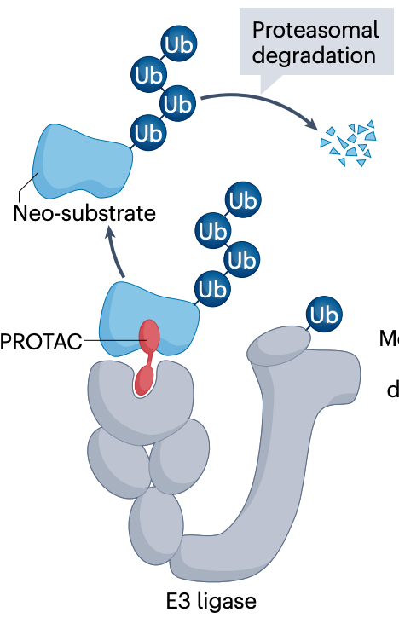
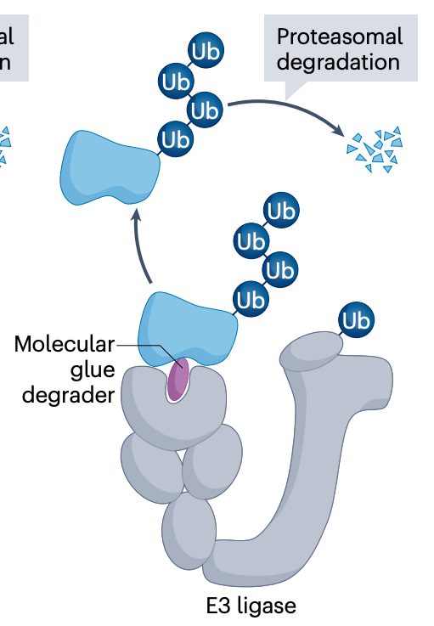
Protein degradation
Tsai, J. M., Nowak, R. P., Ebert, B. L. & Fischer, E. S. Nat. Rev. Mol. Cell Biol. (2024)

Slide 3
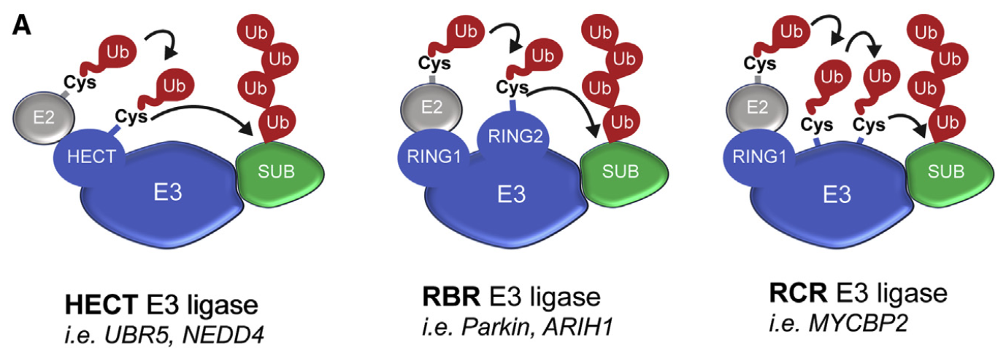
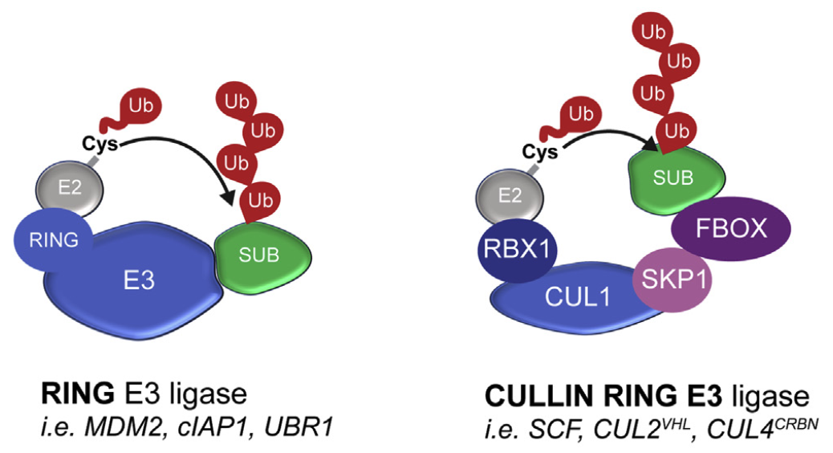
E3 ligases
~600 E3 ligases are encoded in the human genome
Jevtić, P., Haakonsen, D. L. & Rapé, M. Cell Chem Biol 28, 1000–1013 (2021)

Slide 4
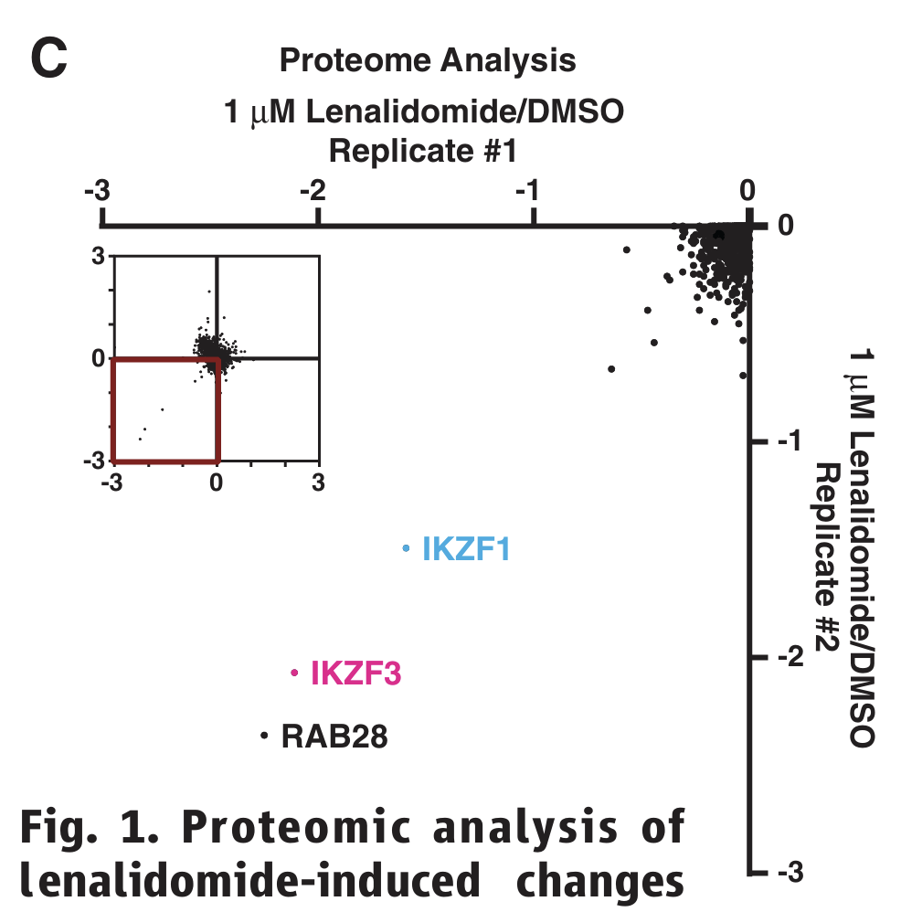
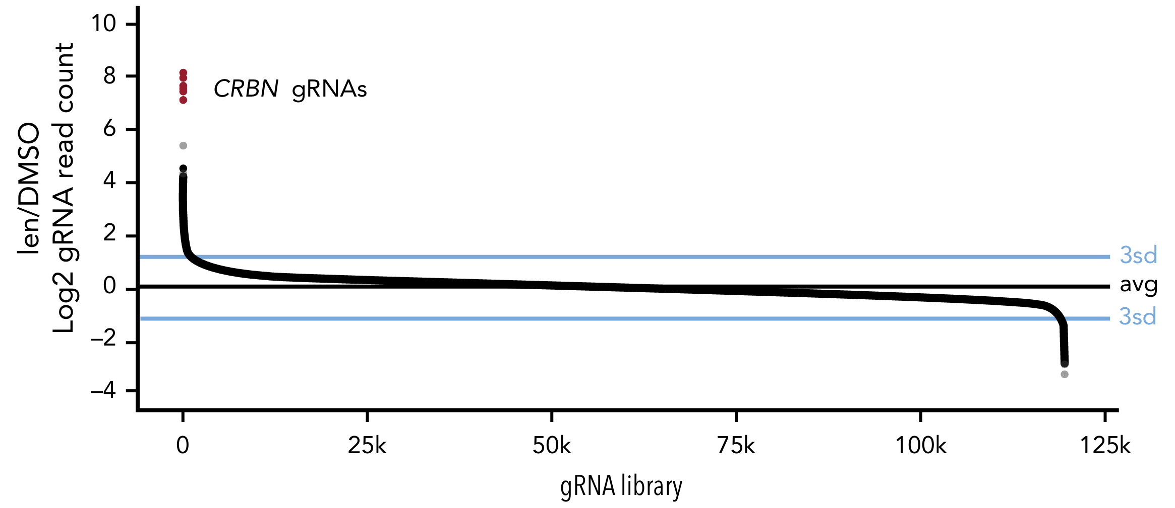
IKZF1 degradation by iMIDs in CRBN-dependent fashion
Krönke, J. et al. Science 343, 301–305 (2014).
Sievers, Q. L. Blood 132, 1293–1303 (2018).

Slide 5
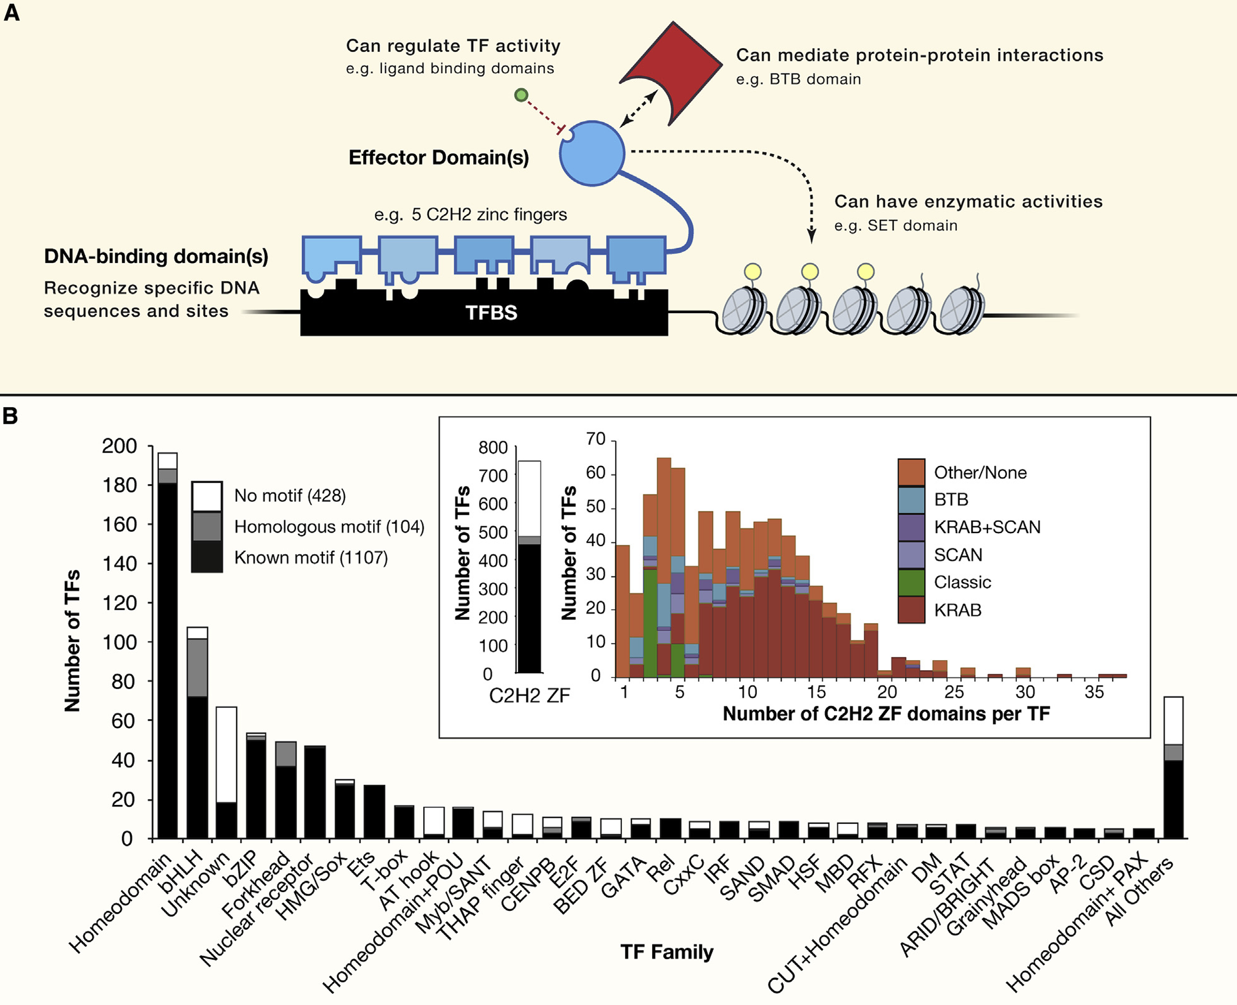
Human transcription factors
Lambert, S. A. et al. Cell 172, 650–665 (2018).

Slide 6
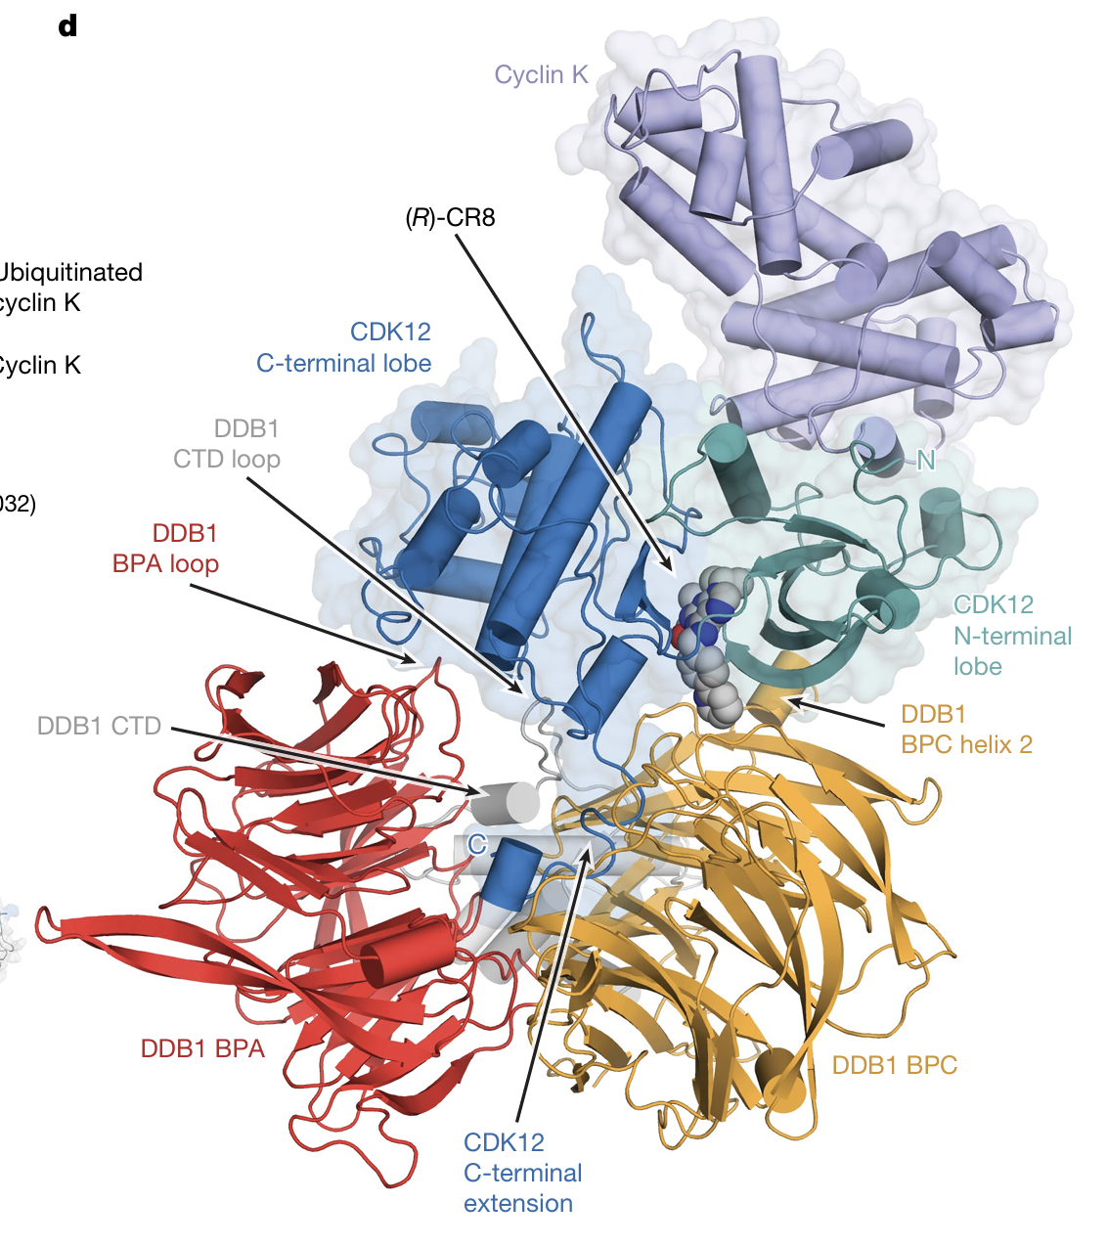
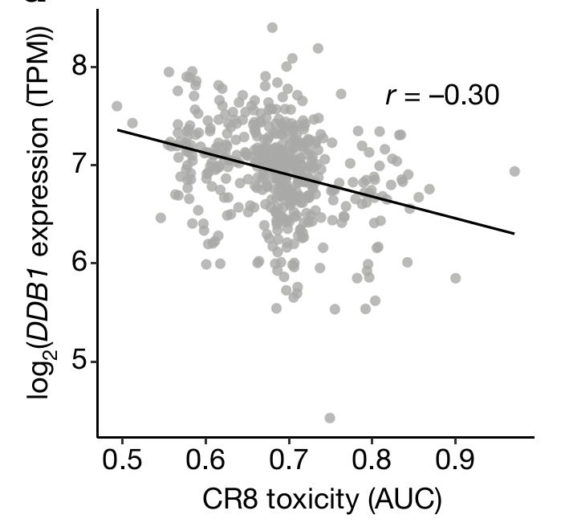
Bioinformatic screen to identify CR8 as molecular glue
Słabicki, M*, Kozicka, Z*, et al. Nature (2020).

